Slide 1






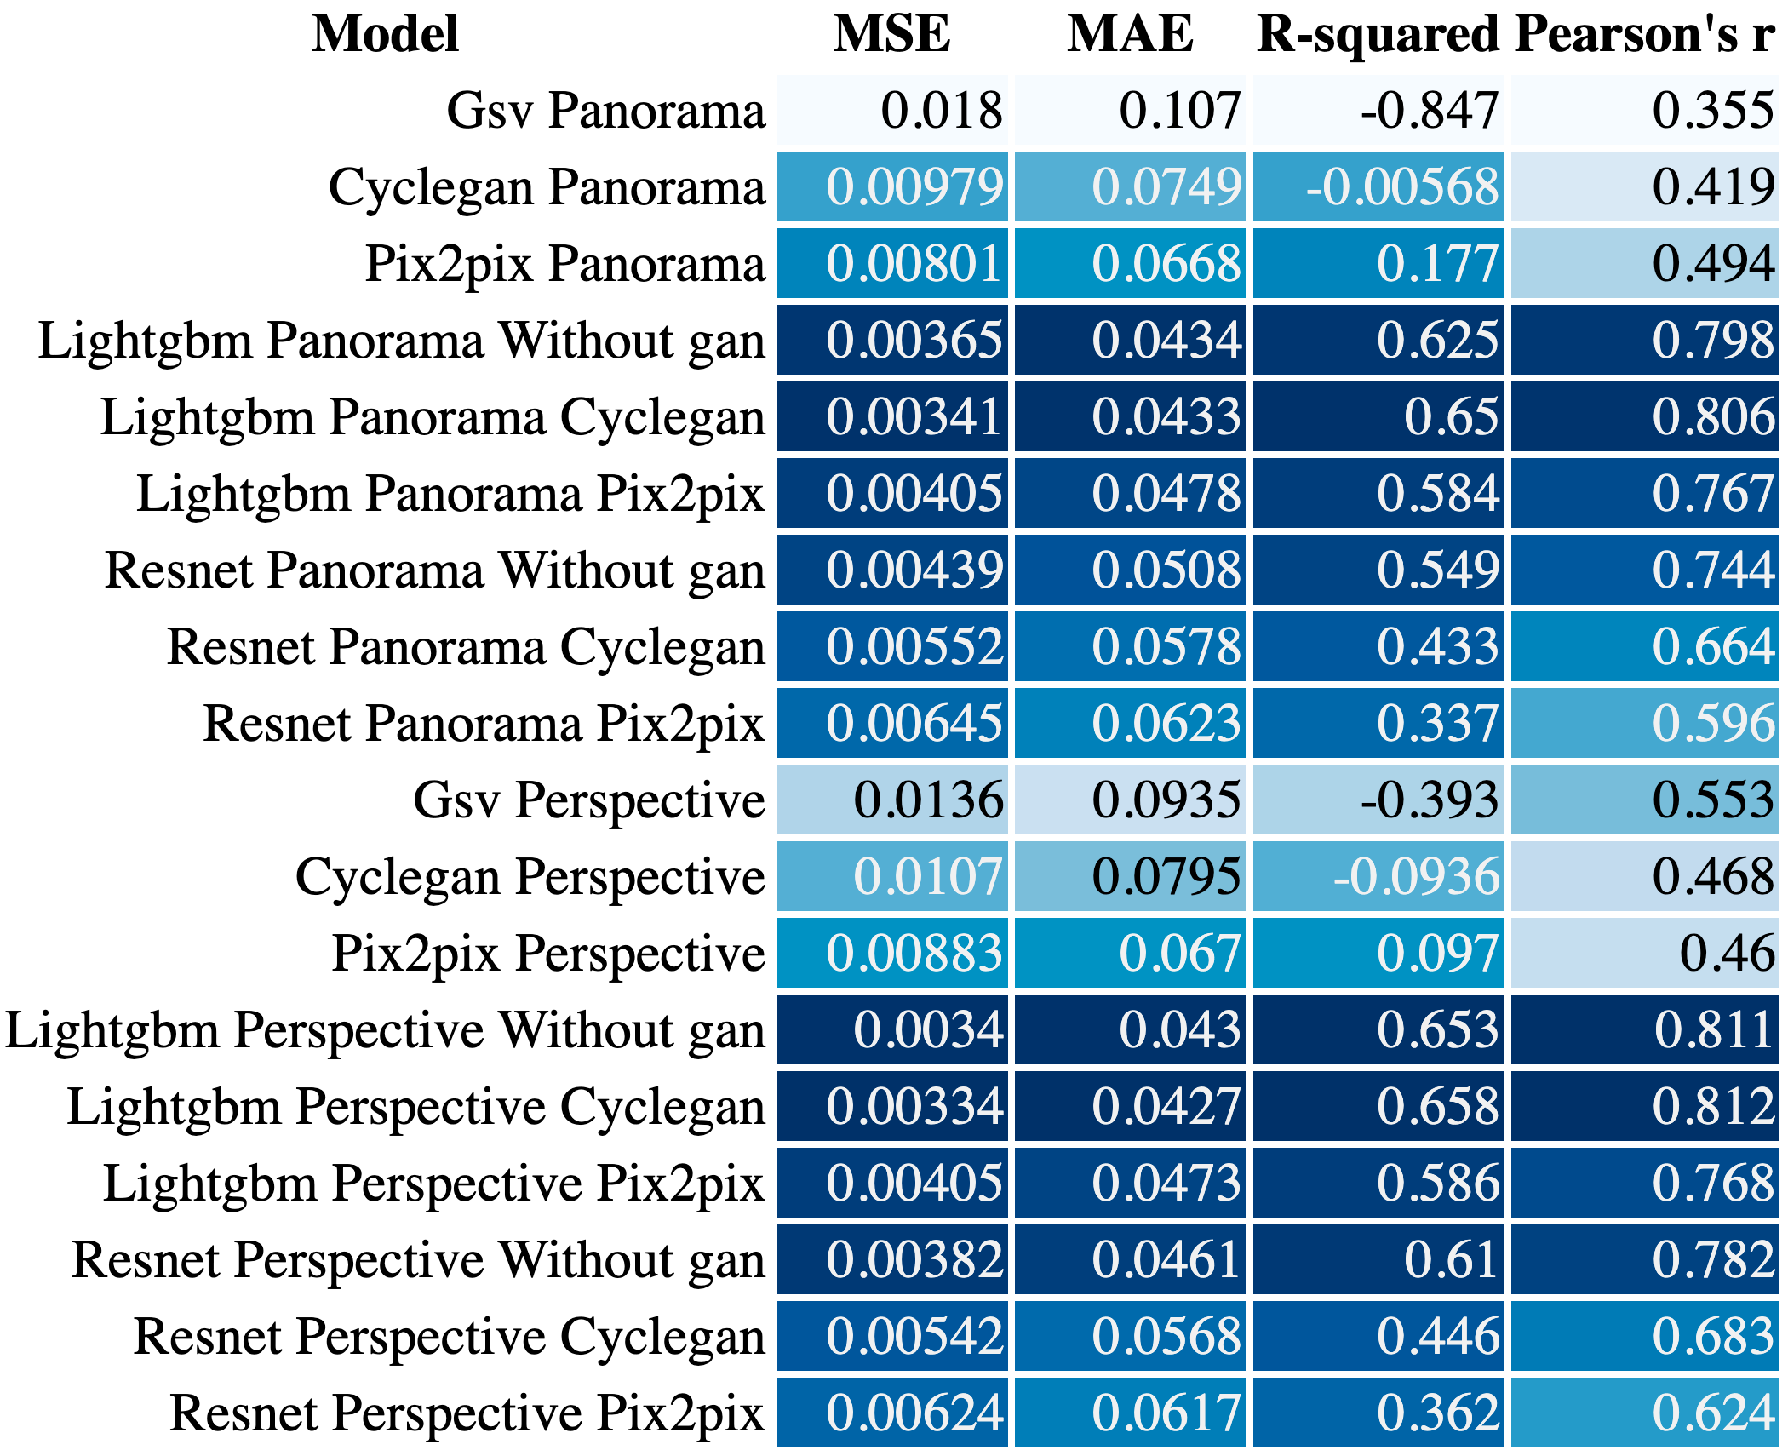
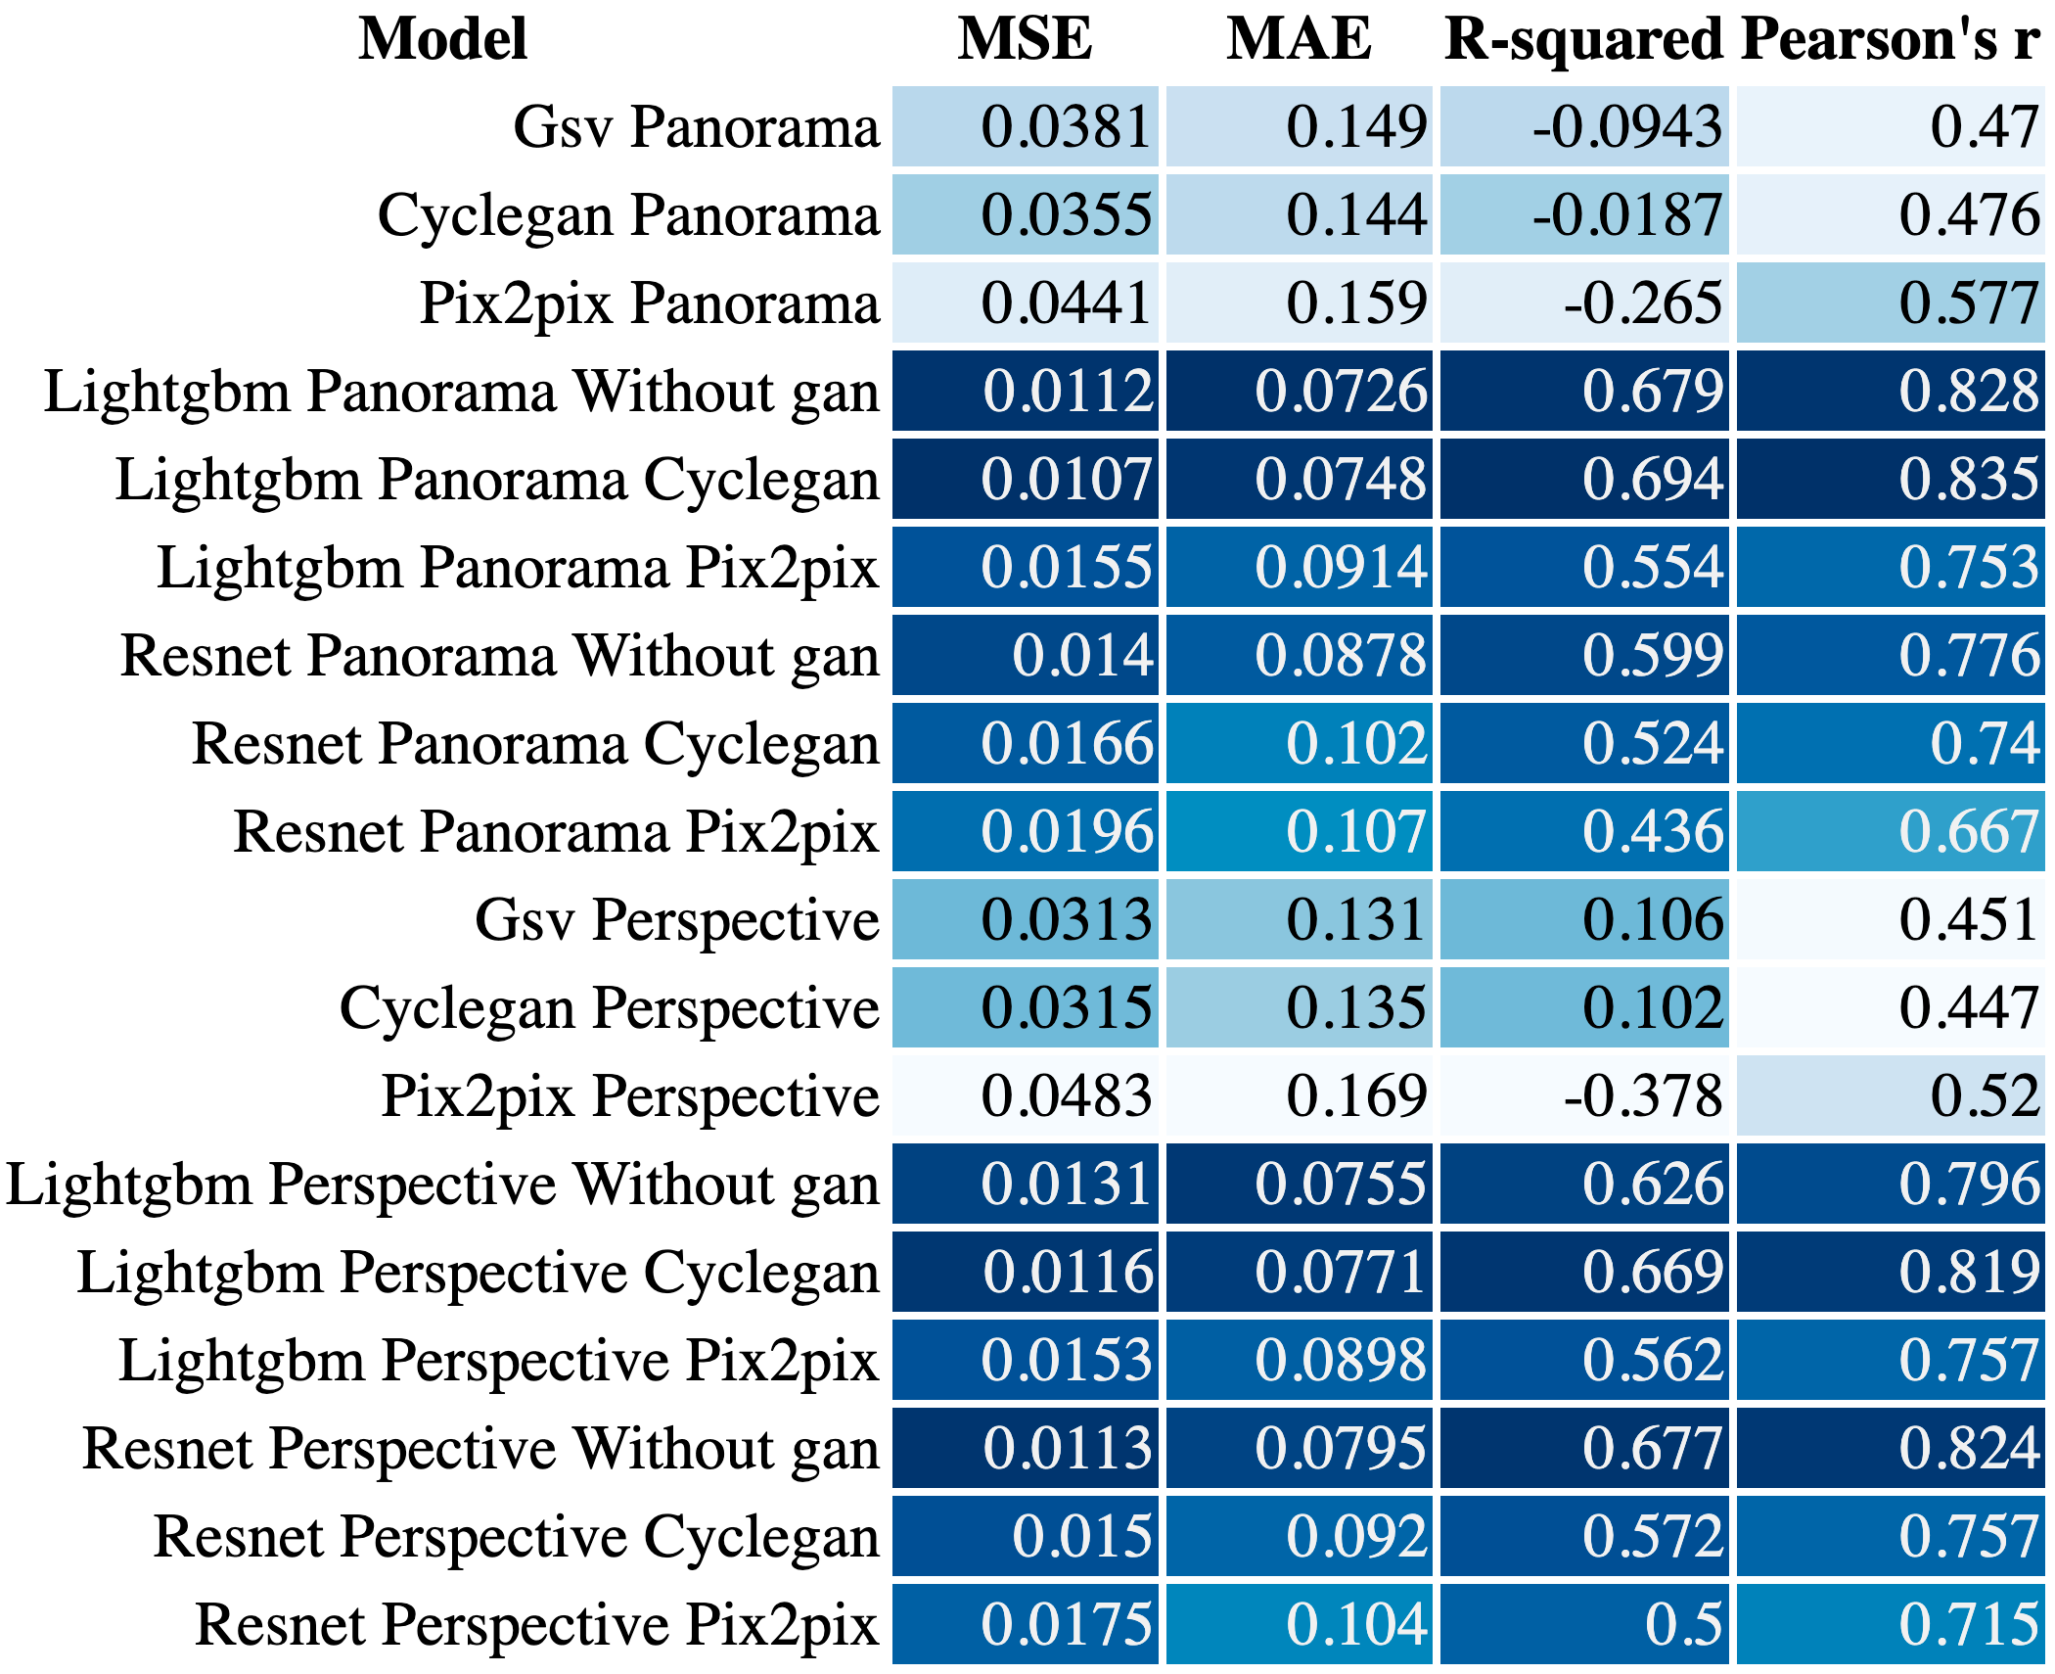
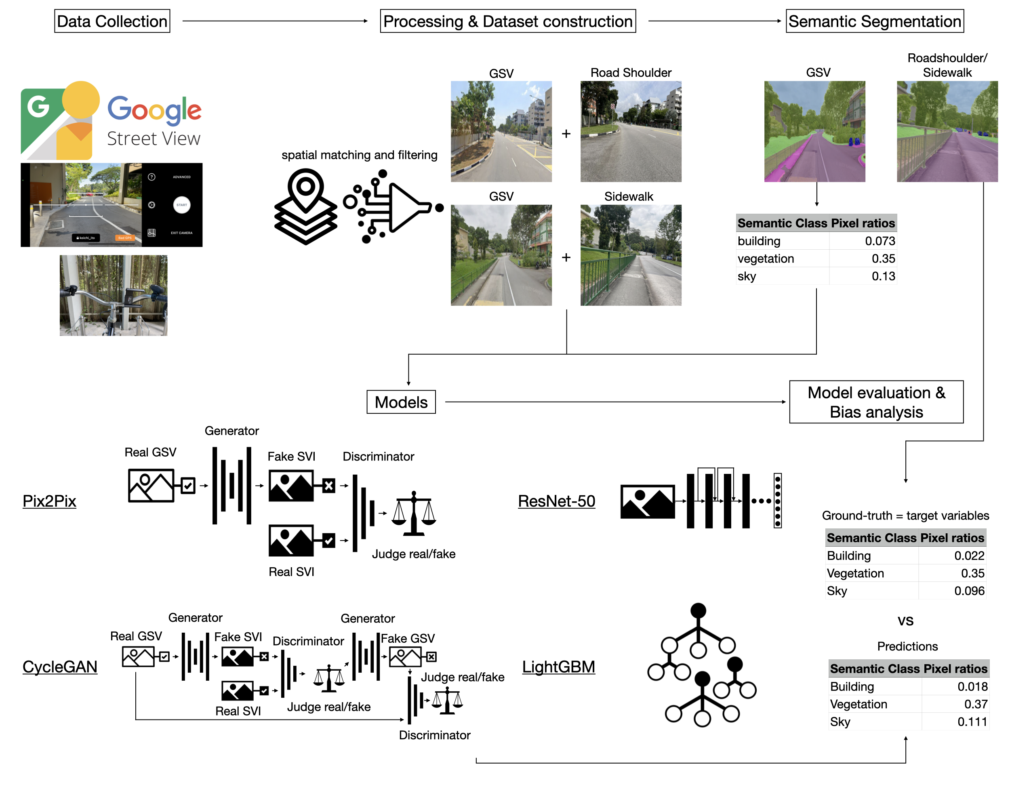
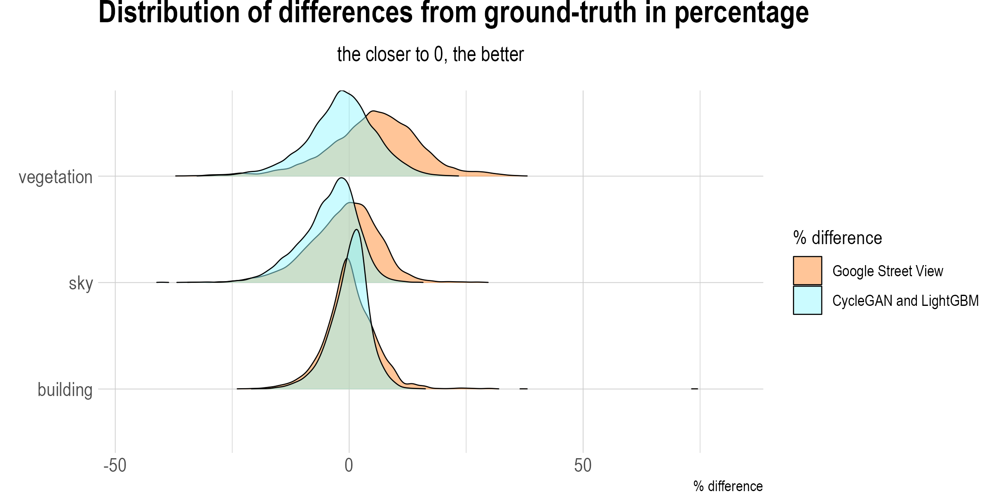
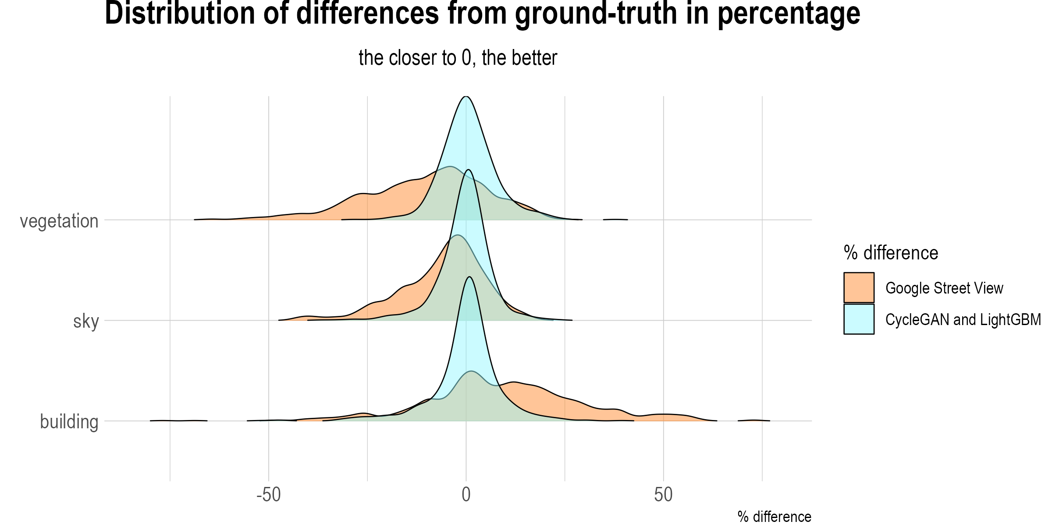
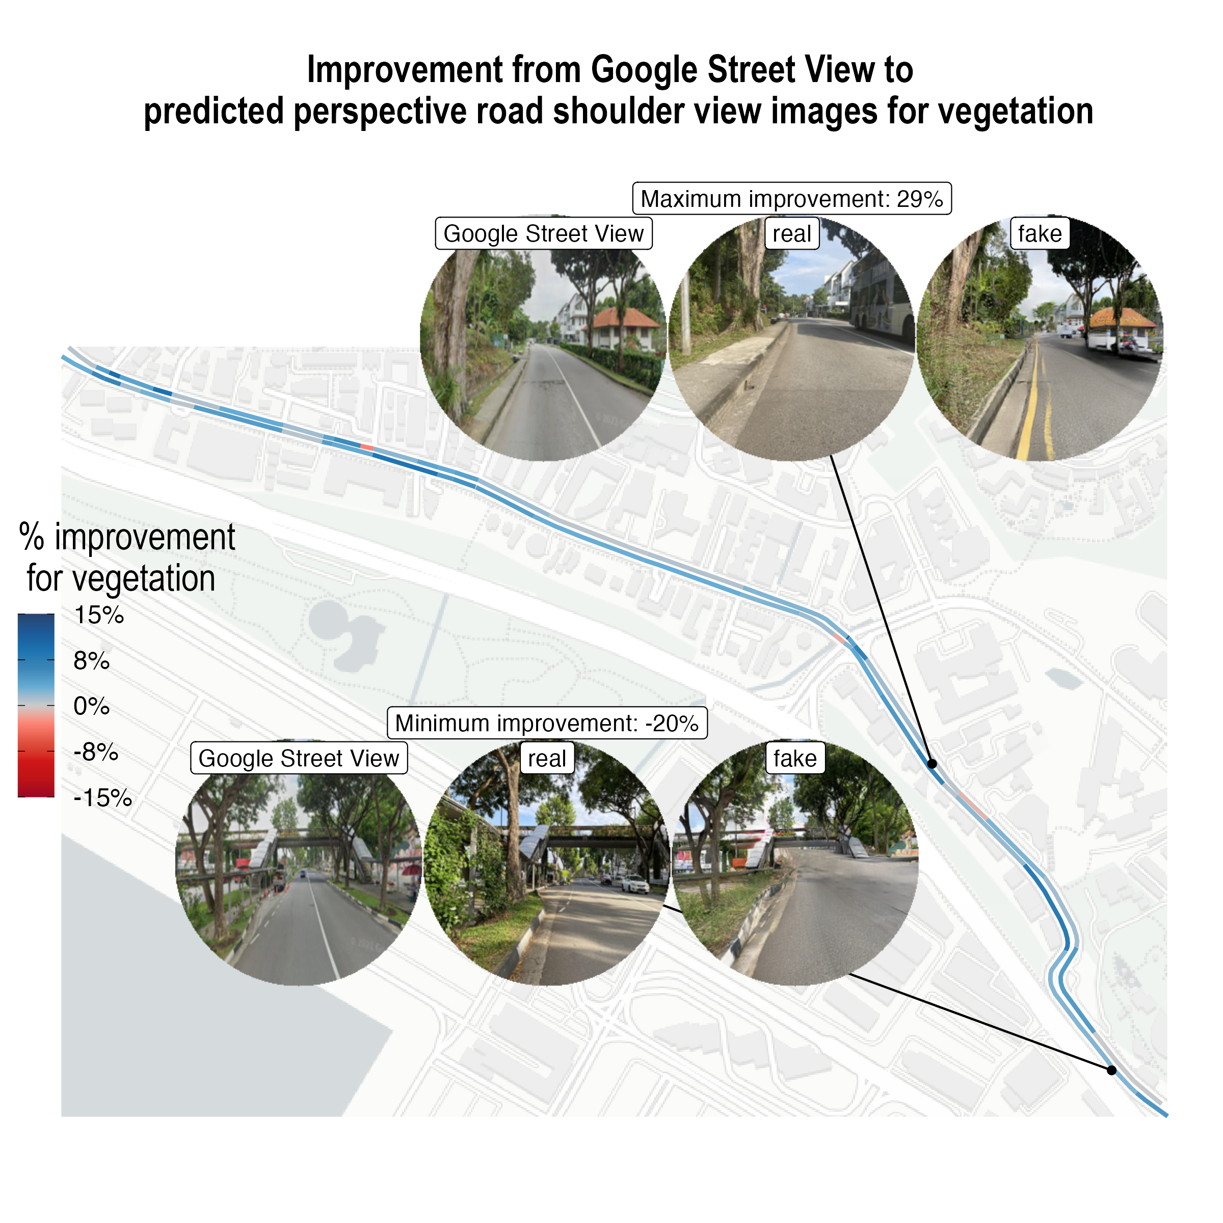
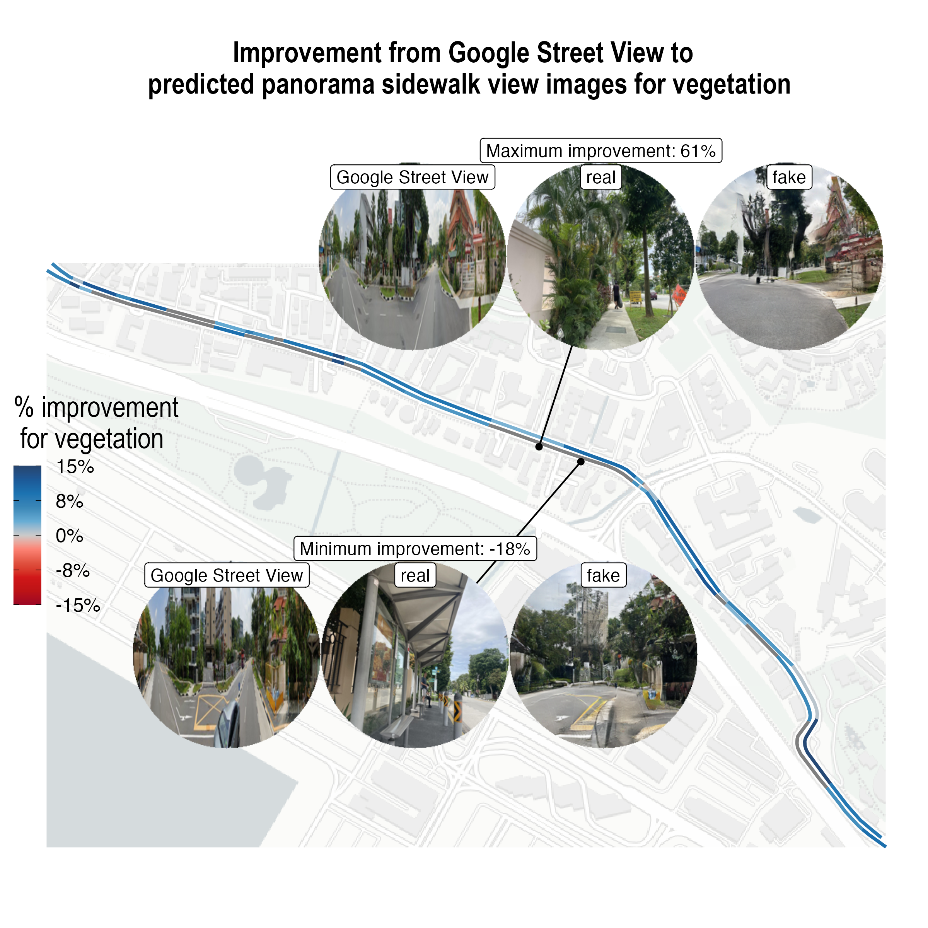
Sidewalk the Talk: Translating street view imagery to correct perspectives to enhance bikeability and walkability studies
Koichi Ito, Matias Quintana, Filip Biljecki
Active transport, bikeability, Generative adversarial
networks, street view imagery, walkability
BACKGROUND
FINDINGS
Active transport plays an important role in improving urban sustainability, and accurate and timely assessment of roads are important.
Google Street View (GSV), road shoulder view, and sidewalk views are weakly correlated, indicating the presence of bias
CycleGAN with perspective input was found to be the best model to mitigate the bias with clear output images
RESEARCH GAP
Street view imagery has been used for walkability and bikeability assessment, but potential perspective bias have not been quantified or attempted to overcome.
Road Shoulder
Sidewalk
AIM
Quantify the bias among platforms.
Try different models to minimize the bias.
METHODOLOGY
Figure 2: Tables of different models’ performance metrics. LightGBM + CycleGAN + Perspective images had the lowest/best MAE and MSE and highest/best R-squared and Pearson’s r for the road shoulder, and LightGBM + CycleGAN + Panorama had the best metrics for the sidewalk.
Figure 1: Framework overview. The Street-View Images (SVIs) are pre-processed and then loaded into two Generative Adversarial Networks (GAN) models, CycleGAN (bidirectional translations) [1] and Pix2Pix (unidirectional translation) [2] for training and inference
Figure 3: Example of available vegetation comparison in a real Street-View Images (SVI) and a generated one.
CONCLUSIONS
This study revealed the presence of perspective bias when using GSV for active mobility analysis.
CycleGAN [1] was able to mitigate the bias.
Generative models can enhance the reliability of scalable SVI-based assessment.
GAN models performed roughly 2 times better (average of original vs generated image similarity) on road shoulder images compared to sidewalk images.
There are still challenges of 1. Data quality and 2. Scalability.
Future studies can leverage simulated 3D virtual environment to overcome the challenges
Future applications
Future studies need to work on further improvement in the data collection/cleaning process
More accurate assessment/intervention of the cycling/walking environment can nudge citizens towards greener, low-carbon transit options.
[1] Zhu, Jun-Yan, et al. "Unpaired image-to-image translation using cycle-consistent adversarial networks." Proceedings of the IEEE international conference on computer vision. 2017.
[2] Isola, Phillip, et al. "Image-to-image translation with conditional adversarial networks." Proceedings of the IEEE conference on computer vision and pattern recognition. 2017.
Contact
Koichi Ito, Ph.D. Student, National University of Singapore, Department of Architecture, Singapore, koichi.ito@u.nus.edu
Acknowledgements
This project was funded by the Singapore International Graduate Award (SINGA) Scholarship. This research was conducted at the Future Cities Lab Global at Singapore-ETH Centre and ETH Zurich. Future Cities Lab Global is supported and funded by the National Research Foundation, Prime Minister’s Office, Singapore under its Campus for Research Excellence and Technological Enterprise (CREATE) programme and ETH Zurich (ETHZ), with additional contributions from the National University of Singapore (NUS), Nanyang Technological University (NTU), Singapore and the Singapore University of Technology and Design (SUTD).

